Slide 1
Unity Catalog

Slide 2
Databricks Data Intelligence Platform
Data Science & AI
ETL & Real-time Analytics
Orchestration
Data Warehousing
Mosaic AI
Delta Live Tables
Workflows
Databricks SQL
Use generative AI to understand the semantics of your data
Data Intelligence Engine
Unified security, governance, and cataloging
Unity Catalog
Unified data storage for reliability and sharing
Delta Lake
Open Data Lake
All Raw Data
(Logs, Texts, Audio, Video, Images)
Notes:
The Data Intelligence Platform then combines this with an Intelligence Engine
This uses generative AI model to understand the semantics of your data and uses that understanding across everything in the platform
Let’s look at some examples of what that means

Slide 3






Databricks Unity Catalog
Unified governance for data and AI
Unified visibility into data and AI
Single permission model for data and AI
AI-powered monitoring and observability
Open data sharing
Databricks Unity Catalog
Discovery
Access
Controls
Lineage
Monitoring
Auditing
Data
Sharing
Tables
Files
Models
Notebooks
Dashboards

Slide 4
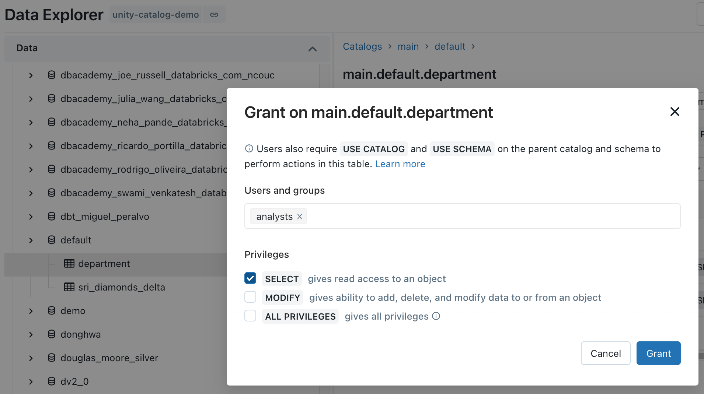
Centralized Access Controls
Centrally grant and manage access permissions across workloads
Using ANSI SQL DCL
Using UI
GRANT <privilege> ON <securable_type> <securable_name> TO `<principal>`
GRANT SELECT ON iot.events TO engineers
Choose permission level
‘Table’= collection of files in S3/ADLS
Sync groups from your identity provider
Notes:
One of the tenants that we embrace as a company, is to make things simple. ANSI SQL DCL, the data control language specification part of ANSI SQL, is a familiar interface for RDBMS users and admins alike. This allows you to grant permission scopes on securable objects like tables or locations to principals like groups, users, or service principals.
The same level of functionality is available via our UI in an easy to use point and click manner, which helps for easy access auditing on the spot.
In addition to that, we offer the ability to set these ACLs on objects via our RESTful APIs, which means that anything, from legacy entitlement request processes to modern dev/sec/ops initiatives can be supported and powered by Unity Catalog.
The interesting thing to note with API and UI based ACL grants, is that they are done outside the context of compute, purely through our control plane APIs.

Slide 5
Row Level Security and Column Level Masking
Provide differential fine grained access to datasets
Only show specific rows
Mask or redact sensitive columns
CREATE FUNCTION <name> ( <parameter_name > <parameter_type> .. )
RETURN {filter clause whose output must be a boolean}
CREATE FUNCTION <name> (<parameter_name>, <parameter_type>, [, <column>...])
RETURN {expression with the same type as the first parameter}
CREATE FUNCTION us_filter(region STRING)
RETURN IF(IS_MEMBER(‘admin’), true, region=“US”);
ALTER TABLE sales SET ROW FILTER us_filter ON region;
CREATE FUNCTION ssn_mask(ssn STRING)
RETURN IF(IS_MEMBER(‘admin’), ssn, “****”);
ALTER TABLE users ALTER COLUMN table_ssn SET MASK ssn_mask;
Test for group membership
Assign reusable filter to table
Test for group membership
Assign reusable mask to column
Specify filter predicates
Specify mask or function to mask

Slide 6
Simplification

Slide 7
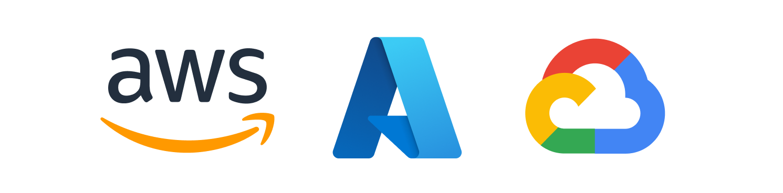
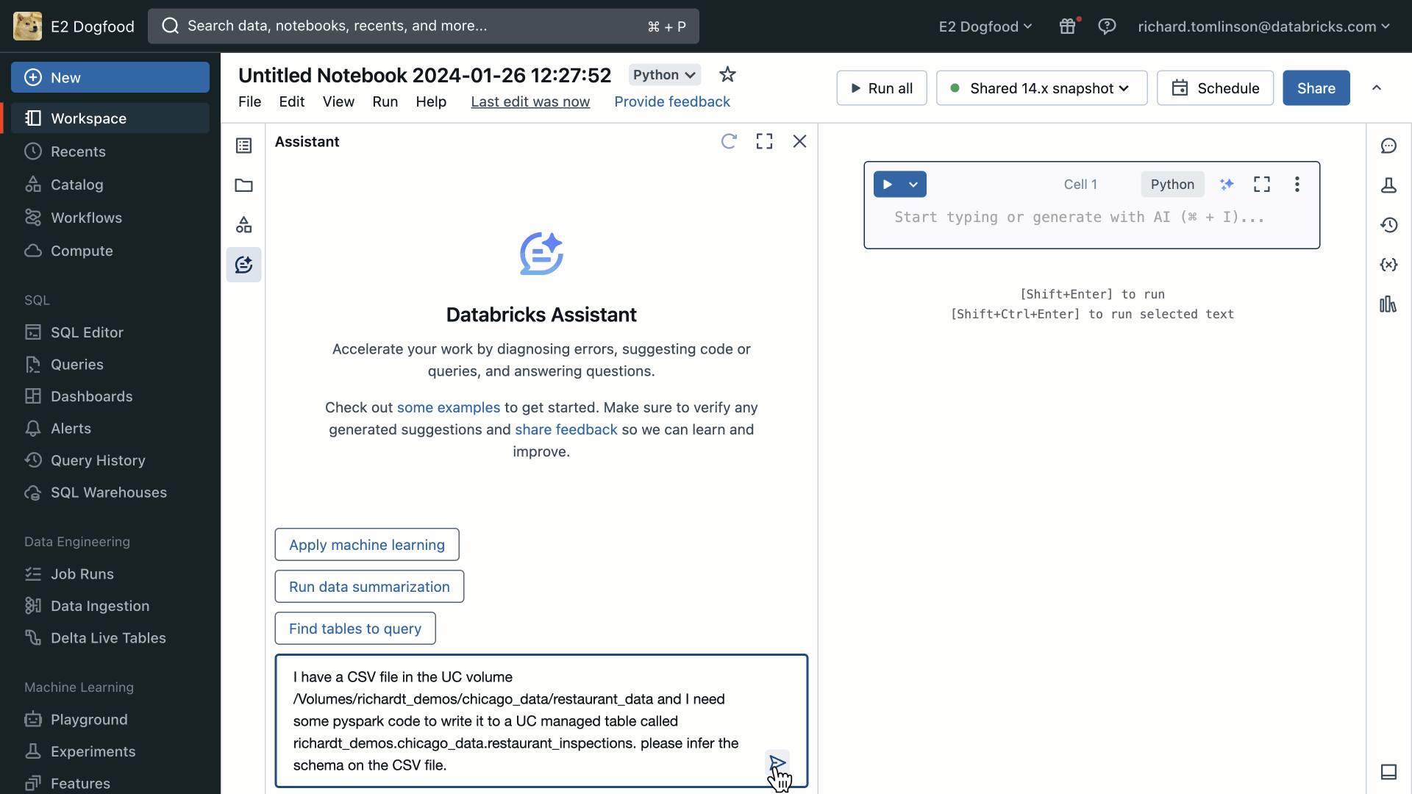

Databricks Assistant
Boost productivity with your context-aware AI assistant
Generate, explain, and fix code with natural language
AI assistance in every developer experience
Uses Unity Catalog metadata for highly relevant answers
“A groundbreaking AI-powered tool that transforms coding productivity!” —Saptagiri Kintali, VP/SDM Data @ Morgan Stanley
“The convergence of generative AI and data development” —Alaeddin Khader, Director Data & AI @ Core42
“I was able to code 200+ lines of robust code this week in a language I've never coded before” —Josue A. Bogran, Solutions Architect Manager @ Kythera Labs
Over 100K
users assisted
in Jan 2024
“This cutting-edge AI companion has revolutionized my data analysis journey, simplifying complex tasks and accelerating productivity.” —Byron Exaporriton, Analytics Engineer @ ABN AMRO
GA
Databricks Confidential
Notes:
First, we are thrilled to announce that Databricks Assistant will shortly become generally available to all users on all clouds. Since we launched Databricks Assistant last year we’ve seen a staggering level of adoption. Just last month alone we noticed over 100 thousand unique users are relying on the assistant to help them generate, explain, and fix python and SQL code with natural language.
As you can see from some of these customer quotes, Databricks Assistant is getting rave reviews. So if you’ve not yet tried it out you should. Its enabled by default in your Databricks workspace so go check it out today.

Slide 8
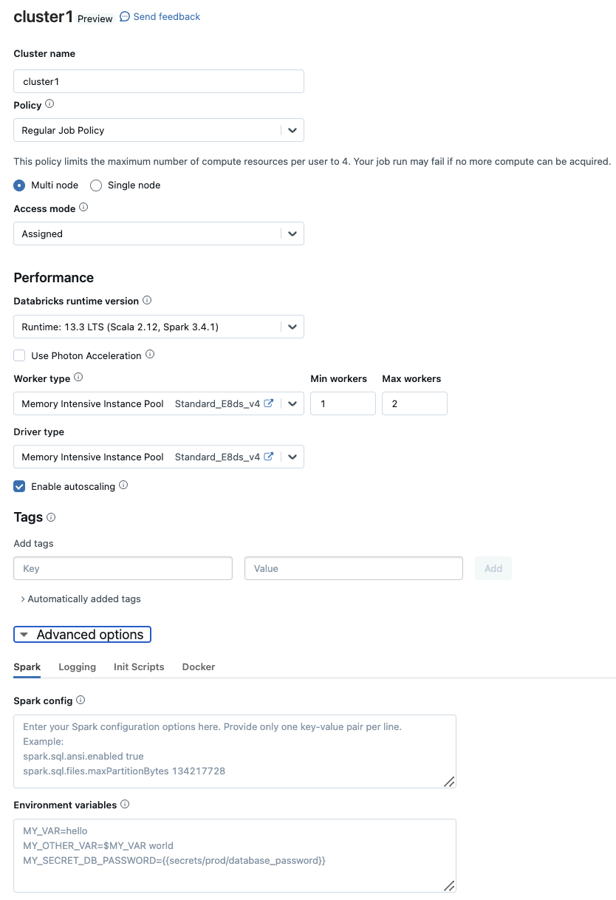

Serverless Compute for Workflows
Hands-off, auto-optimizing compute
Removes the need to manage job clusters by offering cost efficient, highly reliable serverless compute
Complex Infra
SaaS
Efficient, fast-scaling compute with no idle time
Simplifies job setup
Shields users from cloud disruptions
Private Preview on AWS and Azure
Databricks Confidential
Notes:
One of the more important innovations we are bringing is the introduction of serverless compute to Workflows. With serverelss, you will no longer need to define job clusters for tasks and will be able to enjoy a more cost efficient and reliable compute option managed by Databricks.
Serverless compute is currently in private preview and we expect to expand that preview in the coming months

Slide 9
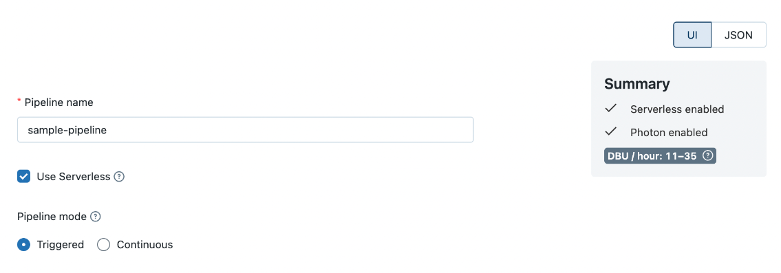
Serverless Compute for DLT
Better reliability and advanced performance optimization
Fully managed, performance optimized compute
Automatic vertical auto-scaling
Incremental Refresh for MV’s for low-latency processing of complex transformations
Fast startup times and low-latency auto-scaling
Currently in Preview
Databricks Confidential
Notes:
Problem: Data teams struggle to optimize cost-performance and reliability of complex pipelines.
Solution: Serverless Compute for DLT provides:
Better reliability
Automatic vertical auto-scaling
Fully managed compute
Advanced performance optimizations
Incremental refresh for MVs (powered by Enzyme) that supports complex transformations with low-latency.
Fast start-up times using a warm pool to handle low-latency use cases
Advanced performance optimizations like micro-batch pippeling for streaming ingestion

Slide 10
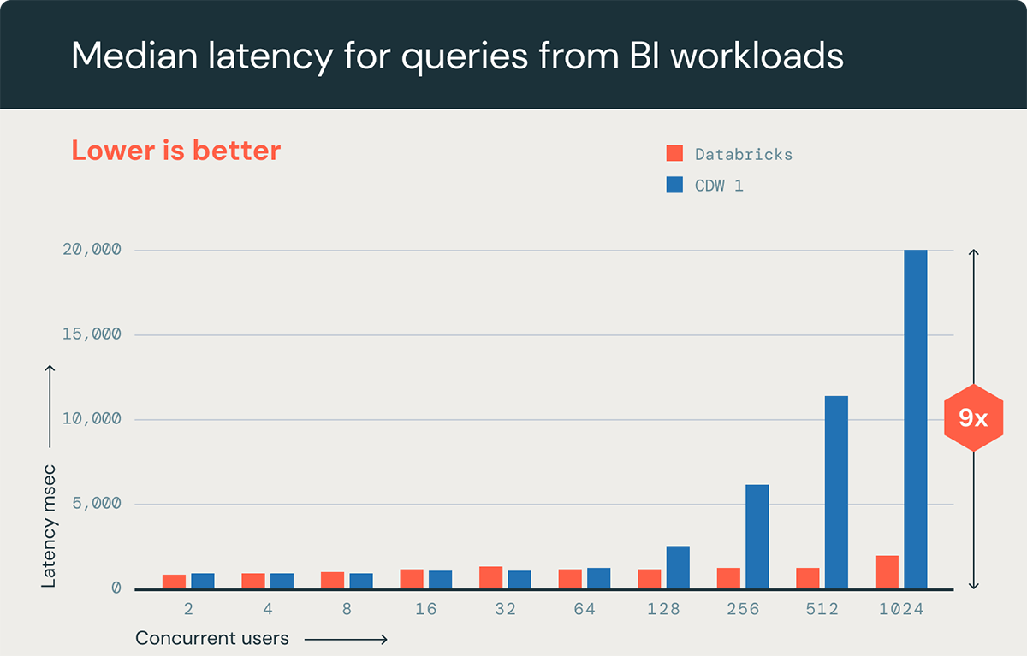
Intelligent Workload Management
Continued Enhancements in H1
Employs machine learning to efficiently route queries and autoscale clusters based on actual workloads
Great for Dashboards, BI queries with bursty traffic or high-concurrency, low-latency requirements
Available with SQL Serverless
Databricks Confidential
Notes:
We are consistently working to improve the speed and performance of Serverless SQL to provide you with the best user experience and TCO. But BI workloads often have changing demand throughout the day as users login and run many dashboards. Users expect these queries to return quickly. However when query loads increase, warehouses may take time to upscale causing some delays the dashboards showing new data.
Solution: today we are announcing the general availability of Intelligent workload management for Serverless SQL warehouses. This feature intelligently responds to the number and size of queries coming in to upscale the warehouse upto 3x faster. This along with read enhancement improvements coming to Predivtive IO will also result in faster query latency for long running BI queries.
Availability: To take advantage of this make sure that Auto-Scaling is enabled for your Serverless SQL Warehouses.
Intelligent Workload Management will be rolling out to all Serverless SQL warehouses on AWS and Azure.
Predictive IO Read Enhancements will come to Serverless SQL and Pro warehouses on AWS in Q4 with Azure and GCP in subsequent quarters

Slide 11
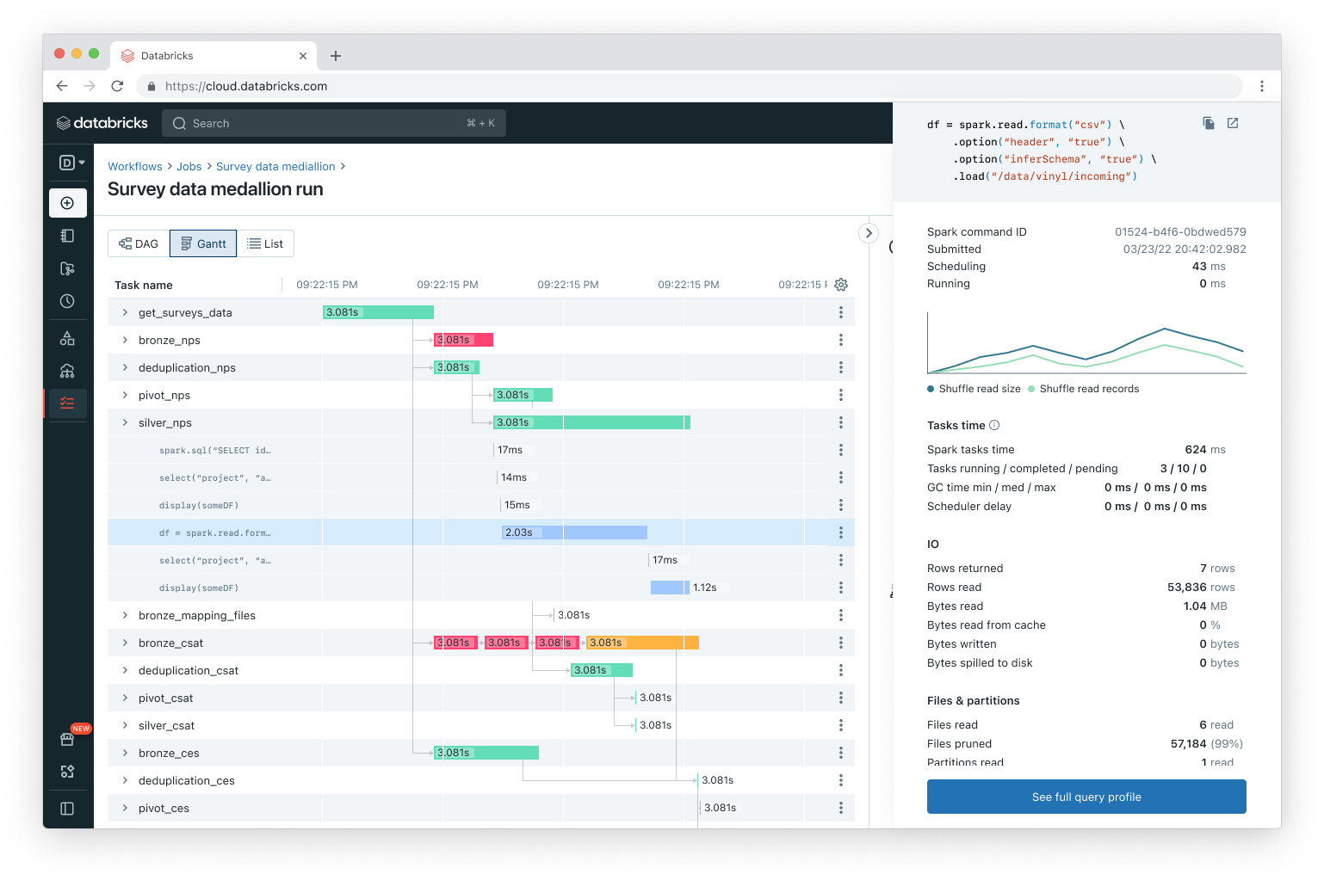
Gantt view of task execution
Improved observability for job runs
New view for job runs allows better visualization of workflow DAGs for troubleshooting and optimizations
Easily understand non-trivial workflow runs
Find workloads optimization opportunities
Diagnose and retry failed or slow tasks
GA in Q1
*Also available in AWS GovCloud
Databricks Confidential
Notes:
Observibility remains an important part of Databricks Workflows and we continuously invest in bringing more experiences that allow our customers to get actionable insights regarding their workflows and how each job runs. We are adding an exciting new visualization to Workflows which is especially useful for non-trivial jobs with multiple tasks. This Gantt view will let you see each job run with the various dependencies and you’ll be able to easily identify which tasks in a job run slowly and where you might have opportunities to optimize.

Slide 12
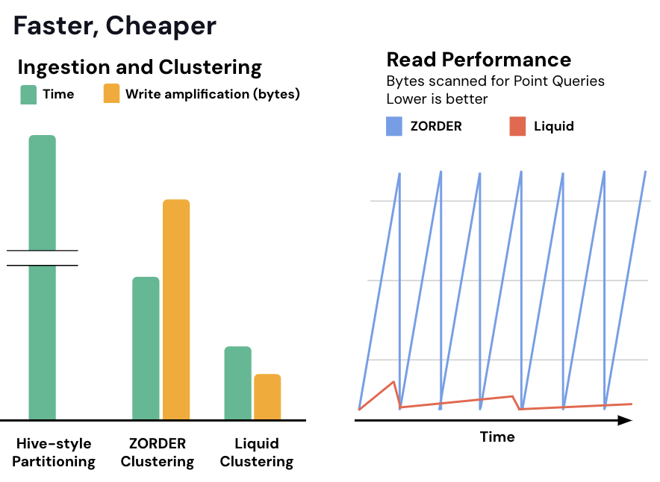
Liquid Clustering
High-performance, easy- to-use clustering—no more headaches with partitions!
Hassle free clustering column selection
Performant, cost-effective incremental clustering
“Liquid clustering has greatly improved the ability of our researchers to investigate complex datasets for specific trends and events. It’s a great option for optimizing point lookups across multiple columns. We look forward to watching this feature grow and be adopted as a key feature of the Delta ecosystem.”
—Cisco
Change clustering columns at any time
GA Q1
Databricks Confidential
Notes:
Partitioning your data provides significant performance benefits, but it’s hard to get right. And even if you manage to find the perfect partitioning strategy for your data right now, it won’t adapt as your data changes over time, forcing you to repartition your data down the road. Liquid Clustering is a new data layout technique with better performance than partitioning. Liquid automatically determines the best clustering approach based on your data and usage patterns, and makes incremental changes over time. Not only is it easy to use, you can change your clustering columns at any time without having to force a data rewrite, and you also have the freedom to pick any column you want regardless of cardinality, which is one of the main limitations of Hive-style partitioning.
This functionality is fantastic for customers like Cisco, who need optimal performance for large scale exploration and discovery across data sets. Liquid helps them optimize their datasets quickly, without the need for static, Hive-style partitioning.
Liquid Clustering is in public preview now and will be going to GA in the first half of this year.
**** IGNORE FROM HERE
Problem
Partitioning provides significant performance benefits, but is challenging to get right - for example, you cannot partition on high-cardinality columns - and if you want to change what columns you partition on, you’ll need to rewrite your entire table. And even in the best partitioning strategies, parts of the table can still be over- or under-partitioned…
Solution
Liquid clustering is an innovative new clustering technique, which provides better clustering performance than existing techniques like partitioning or ZORDER, all while being easier to use. Liquid automatically determines the best clustering data layout, mitigating the risk of tables being over or underpartitioned.
Liquid clustering is performed incrementally and efficiently, providing singifincatly faster than than both Hive partitioning and ZORDER (as seen in the chart on the left). Liquid’s incremental nature also paves the way for more consistent read performance (as seen in the chart on the right)
Liquid is easy to use. Not only can you change your clustering columns at any time without rewrite, but you can also pick clustering columns without considering their cardinality - which you could never do before.

Slide 13
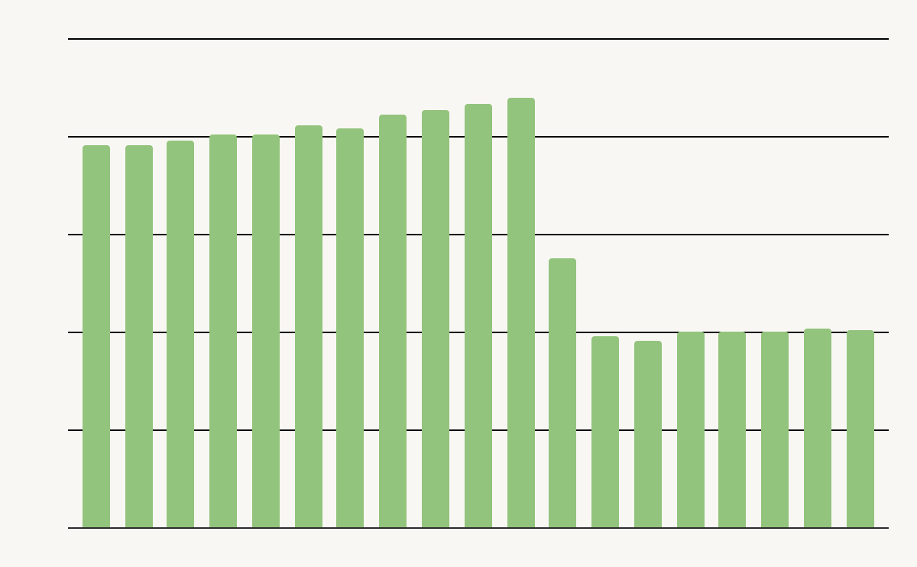
Predictive Optimization
AI-Optimized Delta table layouts
for best price-performance
Customer storage costs
(actual data from Preview customer)
Runs OPTIMIZE, VACUUM, ANALYZE, Liquid clustering
AI model prioritizes tables to maximize ROI
“Databricks’ Predictive Optimizations intelligently optimized our Unity Catalog storage, which saved us 50% in annual storage costs while speeding up our queries by >2x. It learned to prioritize our largest and most-accessed tables. And, it did all of this automatically, saving our team valuable time.”
—Anker
Out-of-box observability with system tables
GA Q1
Databricks Confidential
Notes:
Predictive Optimization solves a problem that many customers don’t realize they have. This feature uses Unity Catalog and DatabricksIQ to determine and schedule the best optimizations to perform on your data and then runs them on dedicated serverless infrastructure. With a simple toggle in your account console, you can start automatically optimizing your Unity Catalog storage and save not only on storage costs, but on the operational overhead you would typically spend on maintenance tasks. Predictive Optimization is seeing strong adoption in Public Preview, with customers like Anker seeing a significant savings in storage costs and better performance for their queries. Predictive Optimization will go to GA in the next quarter.
**** IGNORE FROM HERE
Key takeaway
With Predictive Optimization, Databricks will ensure your tables see optimal performance and cost-efficiency, by automatically performing maintenance on the tables that need it most.
Talking points
With Predictive Optimization, we aim to automatically perform maintenance your Delta tables
This will ensure that your tables see the best performance and cost-effectiveness, while freeing up your time and energy
We do this by automatically running table maintenance operations using serverless jobs
For example, we’ll run OPTIMIZE on tables to improve query performance by optimizing the file sizes for your Delta tables
We’ll run VACUUM on tables to get rid of no-longer-needed files, reducing storage costs
And it’s able to ensure cluster your Liquid tables
We apply Databricks’ AI capabilities to prioritize tables with the highest return-on-investment
And we’ll provide out-of-the-box observability via system tables, so you can see what PO is doing, and what benefits you’re getting
We’re excited to announce that PO will GA at the end of Q4

Slide 14



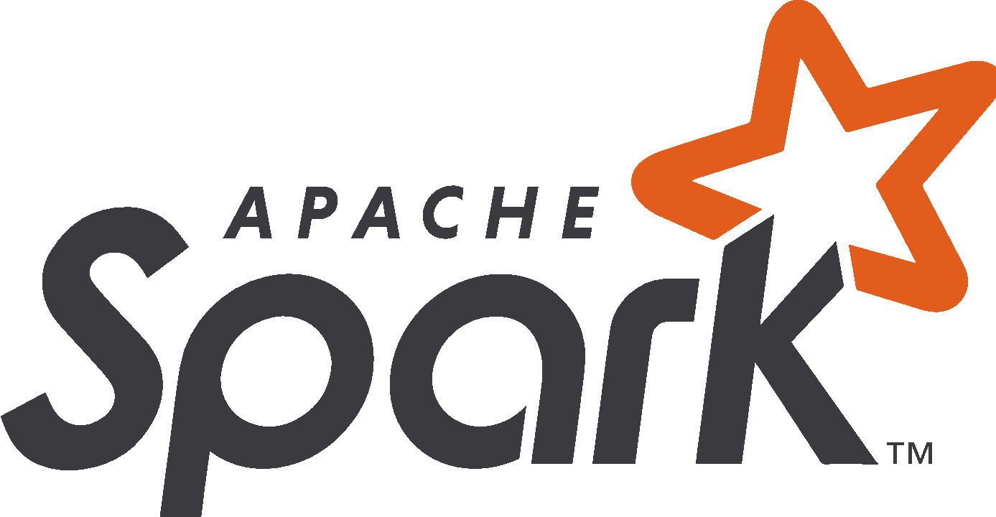
Introducing Enzyme
An automatic optimizer for incremental ETL
Monotonic Append
Delta Tracked
Changes
Partition Recompute
Cost Model
MERGE Updates
Optimal
Update
Technique
Query Plan
Analysis
Full Recompute
+ Catalyst Query Optimizer

Slide 15
AWS PoV

Slide 16
Databricks & AWS - Point of View
Summary: Though AWS offers a comprehensive set of great separate services for different use cases, Databricks on AWS can help you eliminate costs and complexity, and radically accelerate innovation, thanks to unifying all data & AI use cases, as well as governance on one single platform, on a single copy of your data.
 | AWS | Databricks | Opportunities
Lakehouse | Even though a lakehouse architecture can be built on AWS, it would require stitching together a multitude of separate services. Example: S3 as data lake, Redshift as data warehouse, EMR for ETL, Sagemaker for DS/ML, Bedrock for AI | With Databricks, you benefit from a fully managed lakehouse under a single end-to-end platform, built on an open foundation. | Real-time data, insights and models, scalable workloads without runaway costs, and increased efficiency to ship more initiatives to production. Open source and open standards enable easy integration with existing tools, adoption of new technologies, and reliable data sharing with stakeholders regardless of platform.
Governance | Complex multi-service deployments to address different workloads, each with its own governance mechanisms. . Examples: Lake Formation, Instance Profiles / IAM, Glue, etc | Single, unified security and governance model for all data and data & AI assets in your organization. | The right teams get access to the right data at the right time, understanding how data is acquired, changed, used and impacted across every data and AI workload.
Collaboration | Different governance implemented for each silo means teams also become siloed through the tools and data they have access to. | Single, unified and multi-persona (DE, DS, ML, BI) approach that allows all data and AI workloads to operate on a single, unified platform. | No more functional silos means easy collaboration across all your data practitioners.
Data Location | Each service will work on its’ own copy of the data, resulting in duplicative, locked-in and disjointed data silos. Examples: S3, Redshift Cluster Storage, HDFS, RDBMS, vs S3-only (Databricks) | All data and AI use cases are built on top of a single copy of your data - whether structured, unstructured or semi-structured. | Eliminate duplicative costs in storage and complex data engineering.
Performance | AWS services using Spark can suffer from limitations of the OSS version(s). Examples: EMR Spark needs manual tuning and configuration for the compute. | The Databricks Spark runtime benefits from cutting-edge improvements and optimizations, including our own vectorized engine (Photon).than | Reduce costs associated with compute infrastructure, thanks to improved query speed.
Notes:
Not a competition, but a partner of ours. Don’t want to compete.

Slide 17
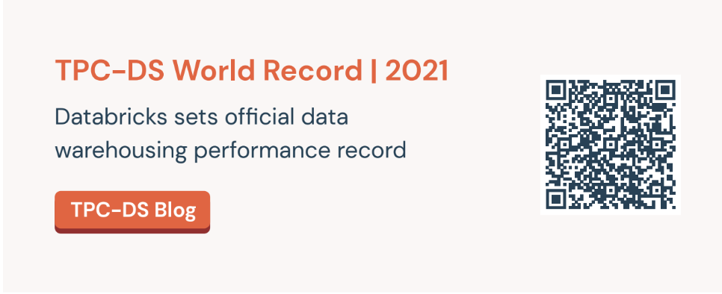

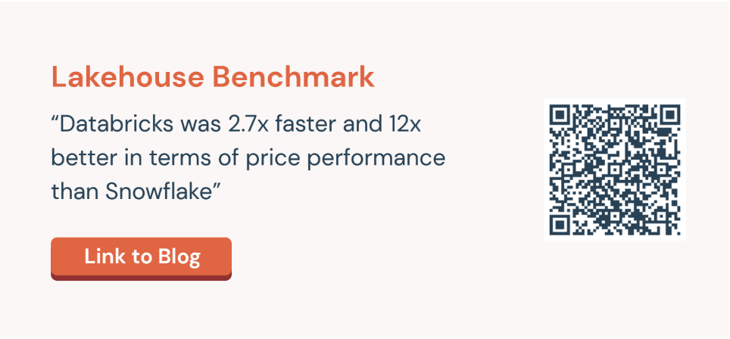
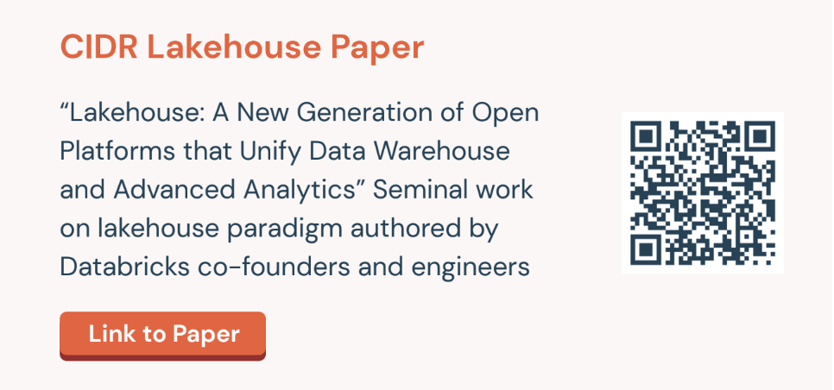
Databricks & AWS - Point of View
Databricks will bring all of the ingredients together in one unified platform to lower TCO and accelerate innovation.
The Databricks Data Intelligence Platform
Unified
Manage all your data and AI use cases (Data Engineering, Streaming, Data Science, Machine Learning, AI, BI) on a simple, end-to-end platform
Govern all your data and data, analytics and AI assets with a single and unified governance and security model (Unity Catalog)
Simple
Streamlined user experience for each step of the data processing workflow, powered by automation that reduces operational and administrative overhead
Collaborative
Databricks offers a multi-persona experience that allows every practitioner to work on the same copy of data with both SQL and Python and to seamlessly collaborate with one another.
Delta Sharing, Databricks Marketplace and Clean Rooms enables open, secure data sharing and collaboration without any vendor dependence.
Multi-Cloud
Databricks is multi-cloud and cloud-agnostic, meaning you will get a consistent experience for all user personas across all clouds. Additionally, you will be able to easily inter-operate across clouds or port data and workloads across when needed
Open
Databricks is a highly-scalable SaaS platform built on widely adopted open source. All your data is stored in open formats
Performant
Delta Lake is the most capable foundation for the lakehouse, providing ACID guarantees, scalable metadata handling, time traveling and unified batch and streaming data processing capabilities - all on one single copy of the data
The Photon engine provides Databricks with the best-in-class performance for all types of workloads
Notes:
We don’t want to spend too much time on this, but thought we would build this slide for you if you want to circulate it with your peers and leadership.

